Slide 1
Primitive and Reference Types
Siraj Eddin Bensasi
172141

Slide 2
What Are Types?
Although JavaScript has no concept of classes, it still uses two kinds of types: primitive and reference. Primitive types are stored as simple data types. Reference types are stored as objects, which are really just references to locations in memory.
JavaScript lets you treat primitive types like reference types in order to make the language more consistent for the developer.
While other programming languages distinguish between primitive and reference types by storing primitives on the stack and references in the heap, JavaScript does away with this concept completely: It tracks variables for a particular scope with a variable object. Primitive values are stored directly on the variable object, while reference values are placed as a pointer in the variable object, which serves as a reference to a location in memory where the object is stored.
primitive values and reference values behave quite differently although they may initially seem the same.

Slide 3
Primitive Types

Slide 4
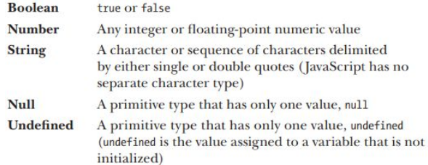
Primitive Types
represent simple pieces of data that are stored as is, such as true and 25.
There are five primitive types in JavaScript:
The first three types (Boolean, number,
and string) behave in similar ways, while the last
two (null and undefined) work a bit differently In JavaScript, as in many other languages, a variable holding a primitive directly contains the primitive value (rather than a pointer to an object).

Slide 5
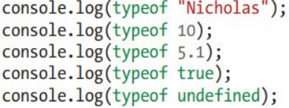
Identifying Primitive Types
The best way to identify primitive types is with the type of operator,
which works on any variable and returns a string indicating the type of data.
Type of returns "string" when the value is a string; "number" when the value is a number (regardless of integer or floating-point values); "Boolean" when the value is a Boolean; and "undefined" when the value is undefined.
But when you run type of null, the result is "object", this has been acknowledged as an error by TC39, the committee that designs and maintains JavaScript.

Slide 6
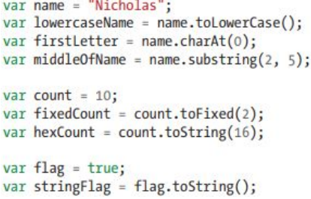
Primitive Methods
spite the fact that they’re primitive types, strings, numbers, and Booleans actually have methods. (The null and undefined types have no methods.) Strings, in particular,
have numerous methods to help you work with them.
Despite the fact that they have methods, primitive values
themselves are not objects. JavaScript makes them look
like objects to provide a consistent experience in the language.

Slide 7
Reference Types

Slide 8
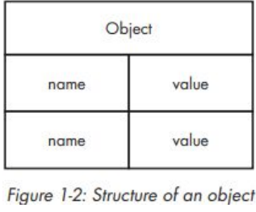
Reference Types
Reference types represent objects in JavaScript and are the closest things to classes, Reference values are instances of reference types and are synonymous with objects.
An object is an unordered list of properties consisting of a name (always a string) and a value.
It sometimes helps to think of JavaScript objects as nothing more than hash tables.

Slide 9

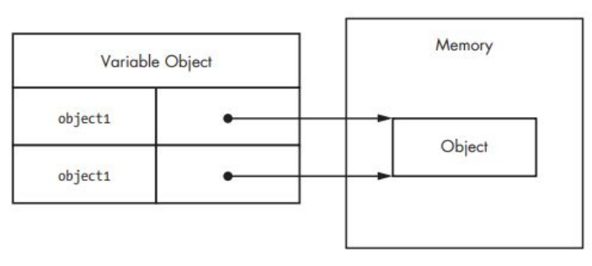
Creating Objects
There are a couple of ways to create, or instantiate, objects. The first is to use the new operator with a constructor.
Reference types do not store the object directly into the variable to which it is assigned, Instead, it holds a pointer (or reference) to the location in memory where the object exists.

Slide 10
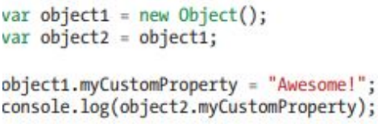
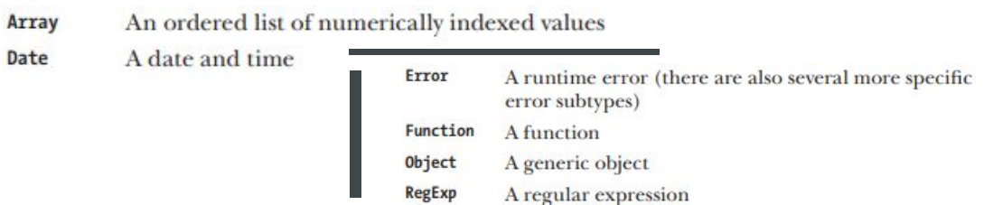
Instantiating Built-in Types
Adding or Removing Properties
The Object type is just one of a handful of built-in reference types that JavaScript provides. The other built-in types are more specialized in their intended usage and can be instantiated at any time. The built-in types are:
In JavaScript you can add and remove properties at any time.

Slide 11
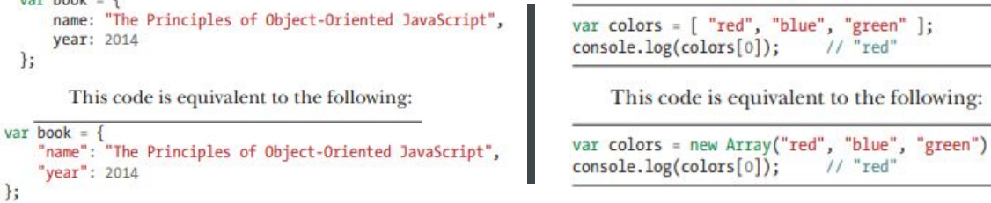
Literal Forms
A literal is syntax that allows you to define a reference value without explicitly creating an object.
Object and Array Literals
To create an object with object literal syntax, you can define the properties of a new object inside braces.

Slide 12
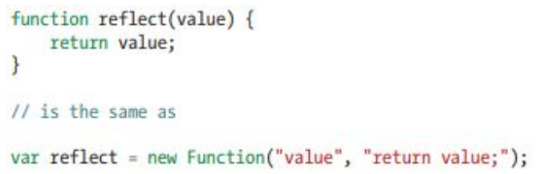
Literal Forms
Function Literals :
Properties are name/value pairs that are stored on an object. Dot notation is the most common way to access properties in JavaScript, but you can also access properties on JavaScript objects by using bracket notation with a string.

Slide 13
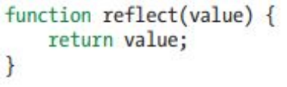
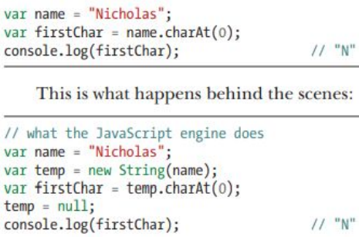
Primitive Wrapper Types
Identifying Reference Types
There are three primitive wrapper types (String, Number, and Boolean). These special reference types exist to make working with primitive values as easy as working with objects. The primitive wrapper types are reference types that are automatically created behind the scenes whenever strings, numbers, or Booleans are read. For example, in the first line of this listing, a primitive string value is assigned to name. The second line treats name like an object and calls char At(0) using dot notation.

Slide 14
Summary

Slide 15
Summary
While JavaScript doesn’t have classes, it does have types. The five primitive types (strings, numbers, Booleans, null, and undefined) represent simple values stored directly in the variable object for a given context. You can use type of to identify primitive types with the exception of null. Reference types are the closest thing to classes in JavaScript, and objects are instances of reference types. You can create new objects using the new operator or a reference literal. Functions are objects in JavaScript, and you can identify them with the type of operator. primitive wrapper types: String, Number, and Boolean. JavaScript creates these objects behind the scenes so that you can treat primitives like regular objects, but the temporary objects are destroyed as soon as the statement using them is complete.

Slide 16

Thanks
Do you have any question?
sasiserag@gmail.com

